Slide 1
Algo-Trading on kite internship
Name: Jayasuryan mutyala
Registeration No: 210962009
branch: cse(aI & ML)
Section: b

Slide 2
Workflow Process
Design and develop an algorithmic trading strategy using:
Price Action Concepts: Hammer, Bullish engulfing, Shooting star and Bearish engulfing.
Support and Resistance lines using fractal candlestick patterns
The trading algorithm is designed based on the fundamental price action concepts and support, resistance lines. While placing a buy or sell order:
Buy Order: The algorithm looks for possible entry points to buy when the closing price is near the support line, and it examines if there is a hammer or bullish engulfing candlestick pattern.
Sell Order: The algorithm looks for possible exit points to buy when the closing price is near the resistance line, and it examines if there is a shooting star or bearish engulfing candlestick pattern. Additionally, there are predefined parameters for take profit and stop-loss so when the closing price meets those target points it will place a sell order.
Perform backtesting
Deploy locally

Slide 3
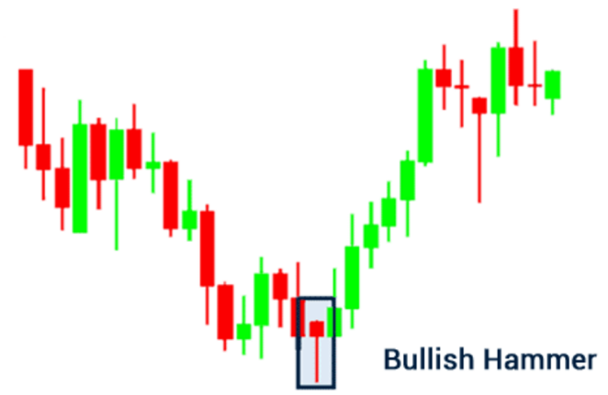
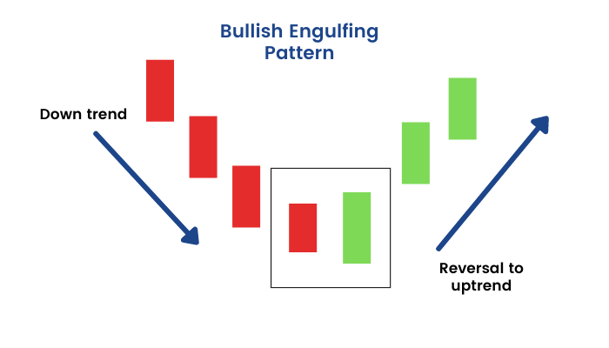
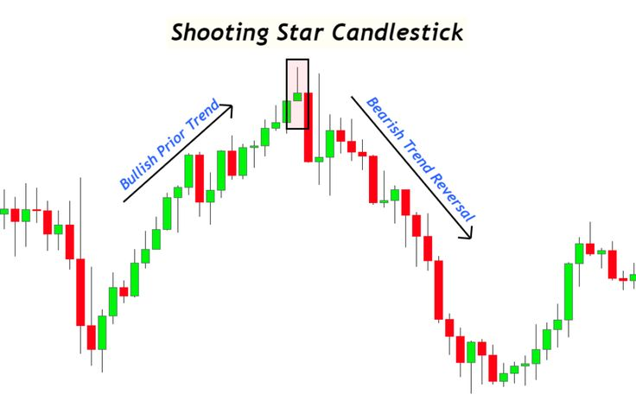
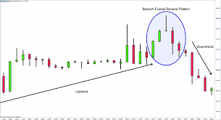
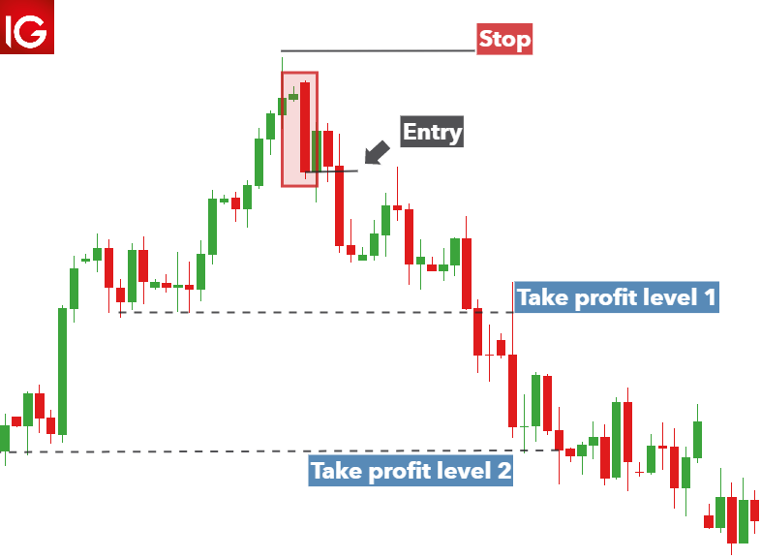
Price action concepts
Bearish engulfing
Fractal

Slide 4
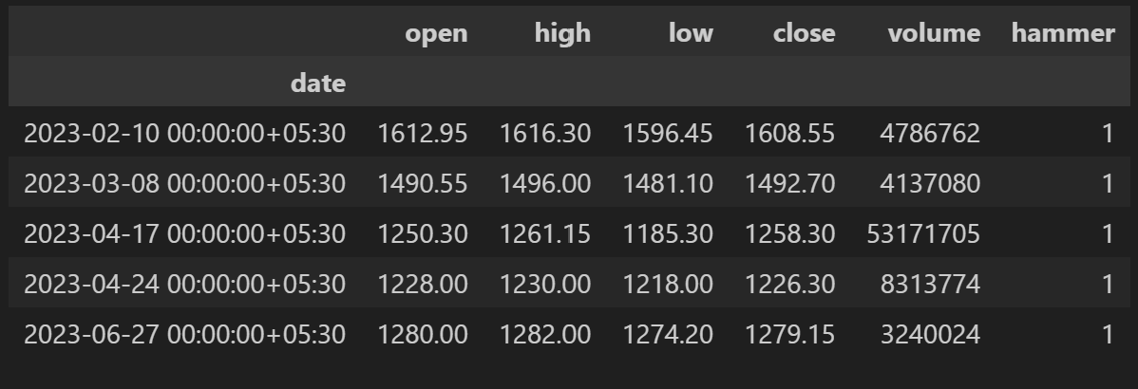
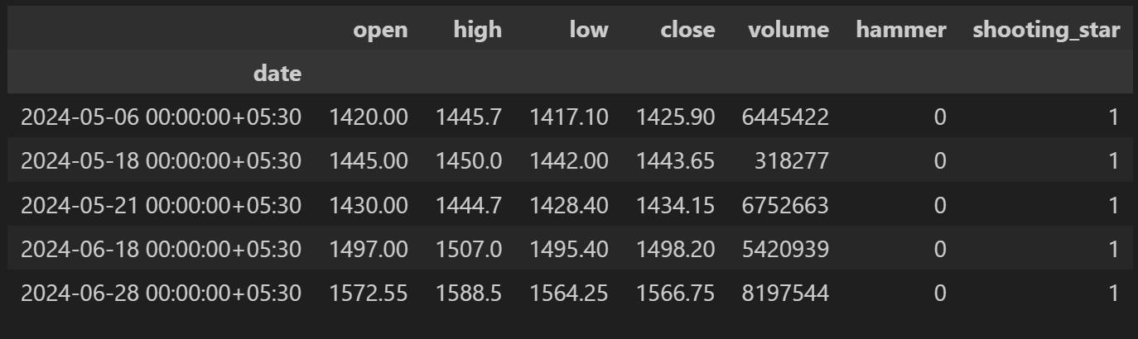
Results of detecting the Patterns
Hammer
Shooting star

Slide 5
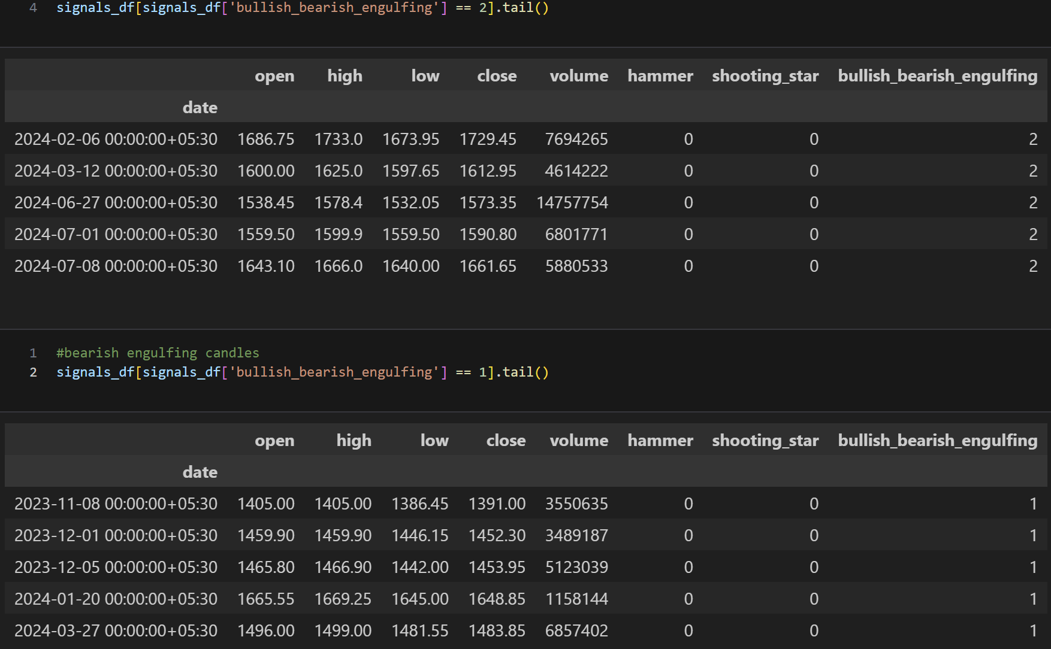
Engulfing pattern (Bullish and bearish)

Slide 6
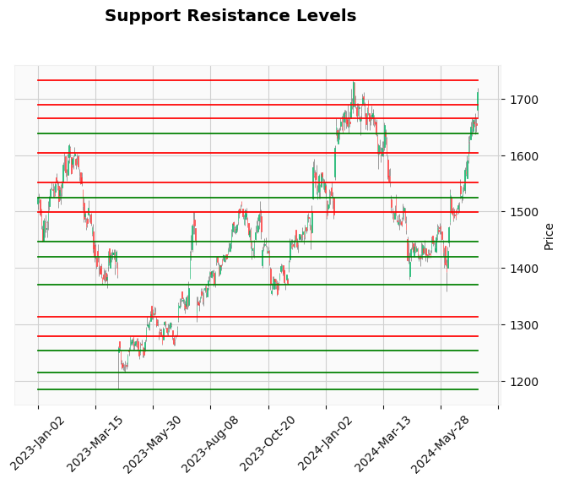
Support-resistance levels
Support and Resistance Identification: The rolling window approach identifies support and resistance levels based on the minimum and maximum prices within a centered window of 5 candlesticks, respectively.
Combining Levels: The identified support and resistance levels are combined into a single series, sorted by date.
Filtering Levels: Significant levels are filtered based on their distance from each other, ensuring that only the most relevant support and resistance levels are retained. These levels are then labeled accordingly.

Slide 7
Simulating orders on historic data
Buy Signal: A potential buy signal is identified when the stock price is near a support level and a bullish pattern (either bullish engulfing or hammer) is detected. Upon meeting these conditions and having sufficient capital, the stock is purchased with predefined stop-loss, take-profit levels, and a trailing stop-loss. The trailing stop-loss is continuously updated if the price increases beyond the profit target.
Sell Signal: A sell signal is triggered if the price reaches the stop-loss, take-profit, trailing stop-loss, or if a bearish pattern (either bearish engulfing or shooting star) is detected near a resistance level.

Slide 8
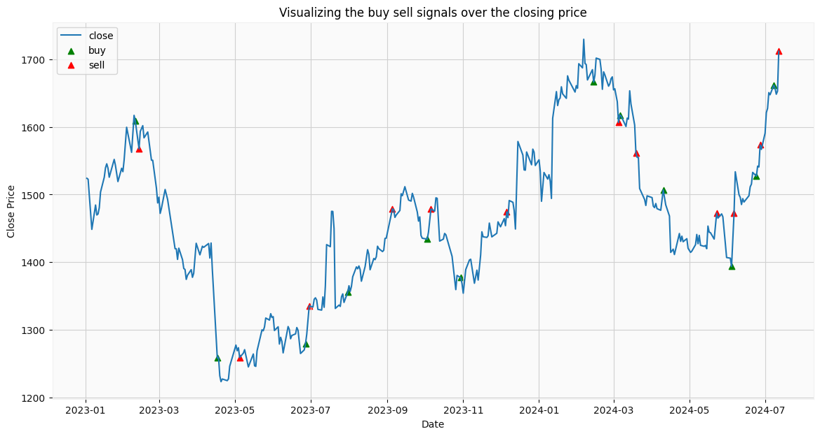

Slide 9
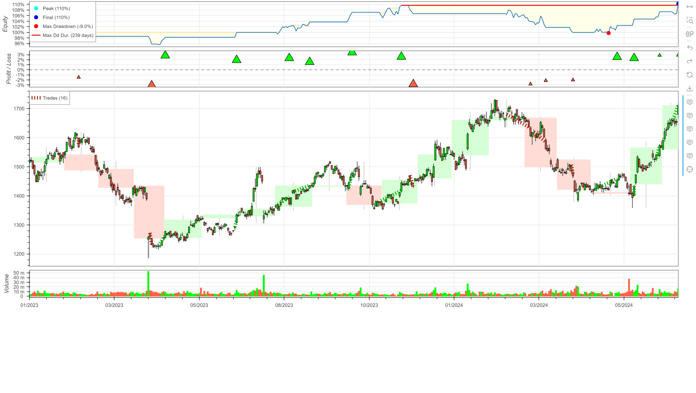
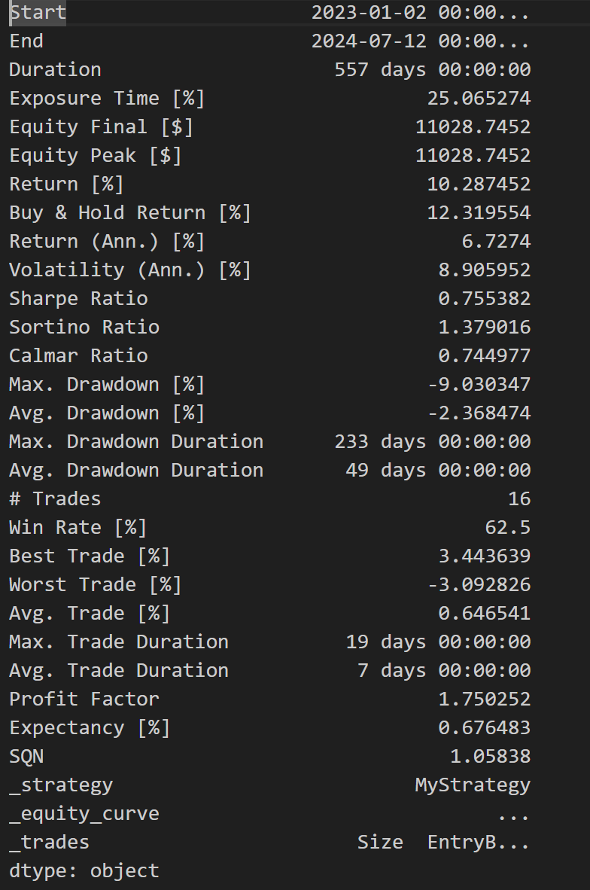
Results from back-testing

Slide 10
Conclusion
Developed an algorithmic trading strategy using Zerodha's Kite API, price action concepts, and support-resistance lines, resulting in a system that automates trades based on historical and live data. Backtesting confirmed effective risk management and consistent returns.
Technical Skills: Enhanced skills in algorithmic trading, applying financial theories, and programming. Successful testing highlighted the potential of automated systems for steady growth with controlled risk.
Adding technical indicators (MACD, RSI), implementing machine learning models (LSTM), optimizing parameters, expanding backtesting, enhancing risk management, developing a performance dashboard, and improving error handling and logging.

